Slide 1
READING COMPREHENSION: FICTIONAL TEXTS
SHSAT English - Week Four
Notes:
Cr: Arin Faruque for qs and as
Shout-outs to Jett, Sanaa, and Ebony! (Evening)

Slide 2
GENERAL APPROACH FOR READING COMPREHENSION PASSAGES
01
ACTIVE READING
02
READ THE QUESTIONS AND ANSWER CHOICES
03
PREDICT AND ANSWER!
Read the passage while taking notes. Summarize the plot and main ideas.
Predict the answer based on your reading, then go back to the relevant section in the passage and find the answer.

Slide 3
TWO IMPORTANT ELEMENTS IN FICTIONAL TEXTS
TONE
THEME
An attitude such as sad, humorous, etc. that the author tries to convey using specific words. Try identifying the tone as you read the passage. If the author uses words such as “delightful”, “joy”, the tone is happy. If you see words such as “terror”, “dread”, the tone is fearful.
The overall idea, moral, or lesson. Think, “What does the author want me to know after reading the passage?” For example, Macbeth contain themes such as “the dangers of unchecked ambitions” and “the difference between appearance and reality”.

Slide 4
TYPES OF QUESTIONS
you’ll encounter for this text type

Slide 5
1. FUNCTION
This question asks you to consider why or how the author uses a certain phrase, opinion, example, or paragraph. Think about the author’s intention (this has to do with the tone + theme they want to convey) and context. Take note of transition words, and read around the cited text for context.

Slide 6
Example of a Function Question
> For larger portions of the text (like here where they ask you about multiple paragraphs), skim the paragraphs and think about how they relate to each other.
(Don’t get too caught up on details when the question asks for such a broad portion of the text.)

Slide 7
2. MAIN IDEA
This question asks about the theme or central idea of the passage. Take notes during the active reading to help you identify the main ideas.
Common traps:
Too narrow: The answer choice covers some ideas that were discussed, but not all of them.
Too broad: The answer choice may cover some or all ideas in the passage, but also covers those that are not mentioned.

Slide 8
Example of a Main Idea Question
> Direct “What is the main idea of the text” questions are uncommon in fictional passages.
> Most of the time, they exist in combination with a function question where you have to analyze the impact of a certain portion of the text on the central idea. But in these questions, you must still identify the the main idea first.

Slide 9
3. DETAIL
This question asks about a specific information from the passage, such as a word, phrase, or idea. Use paragraph references to find the relevant section (“In paragraph 3…”). Use evidence from the passage to answer the question. Whatever the question is asking, the paragraph must provide the details. Also read the sentence before and after the evidence for context.

Slide 10
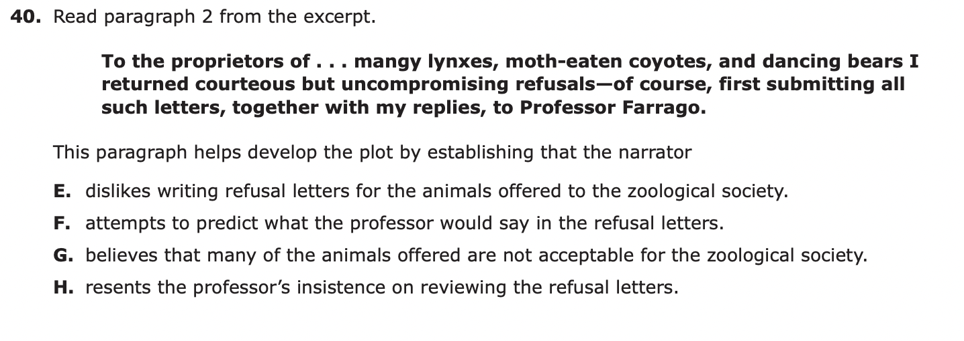
Example of a Detail Question
> Please make sure to go back to the part of the text the question asks about to understand the context of the excerpt given!
> Try not to rely on memory as different contexts can give completely different answers to questions.

Slide 11
4. INFERENCE
This question asks you to draw conclusions based on information in the passage and contain words such as “imply” or “suggest”. Think about the author’s POV and why they chose to write a certain way.
Common traps:
Answers to inference questions do not discuss something explicitly stated in the passage.

Slide 12
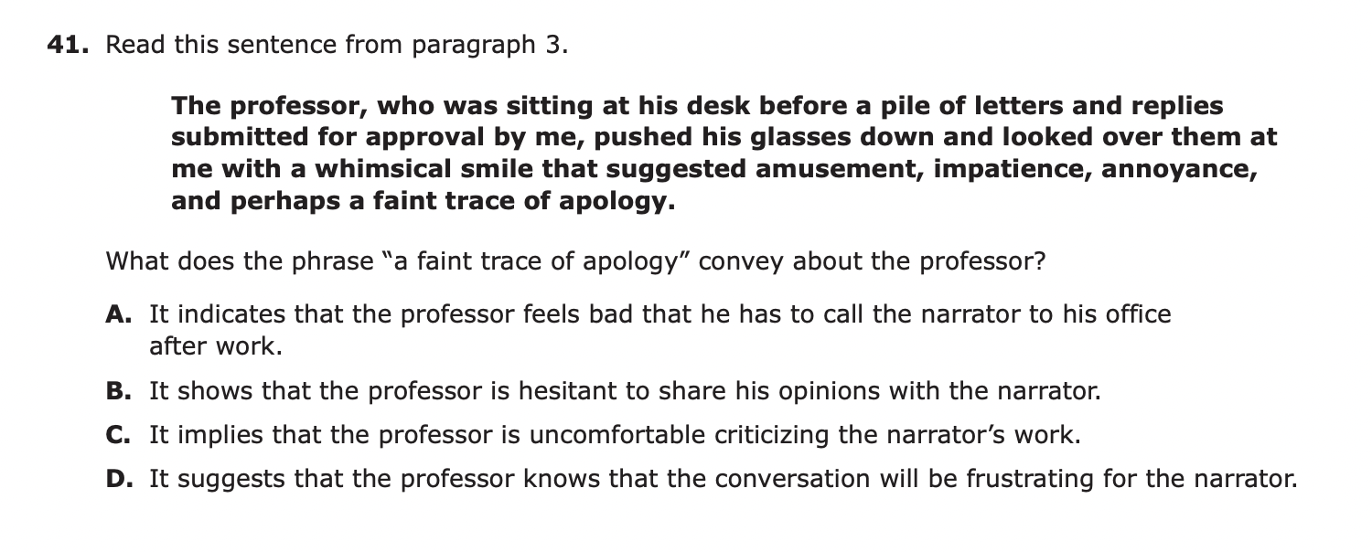
Example of a Inference Question
> An inference question is often given with a specific excerpt or portion of the text.
> Be especially careful with the wording of the answer choices for these types of questions- subtle differences can make one answer more correct than the other!

Slide 13
GEOMETRY: ANGLES, POLYGONS, AND CIRCLES
SHSAT Math - Week Four

Slide 14
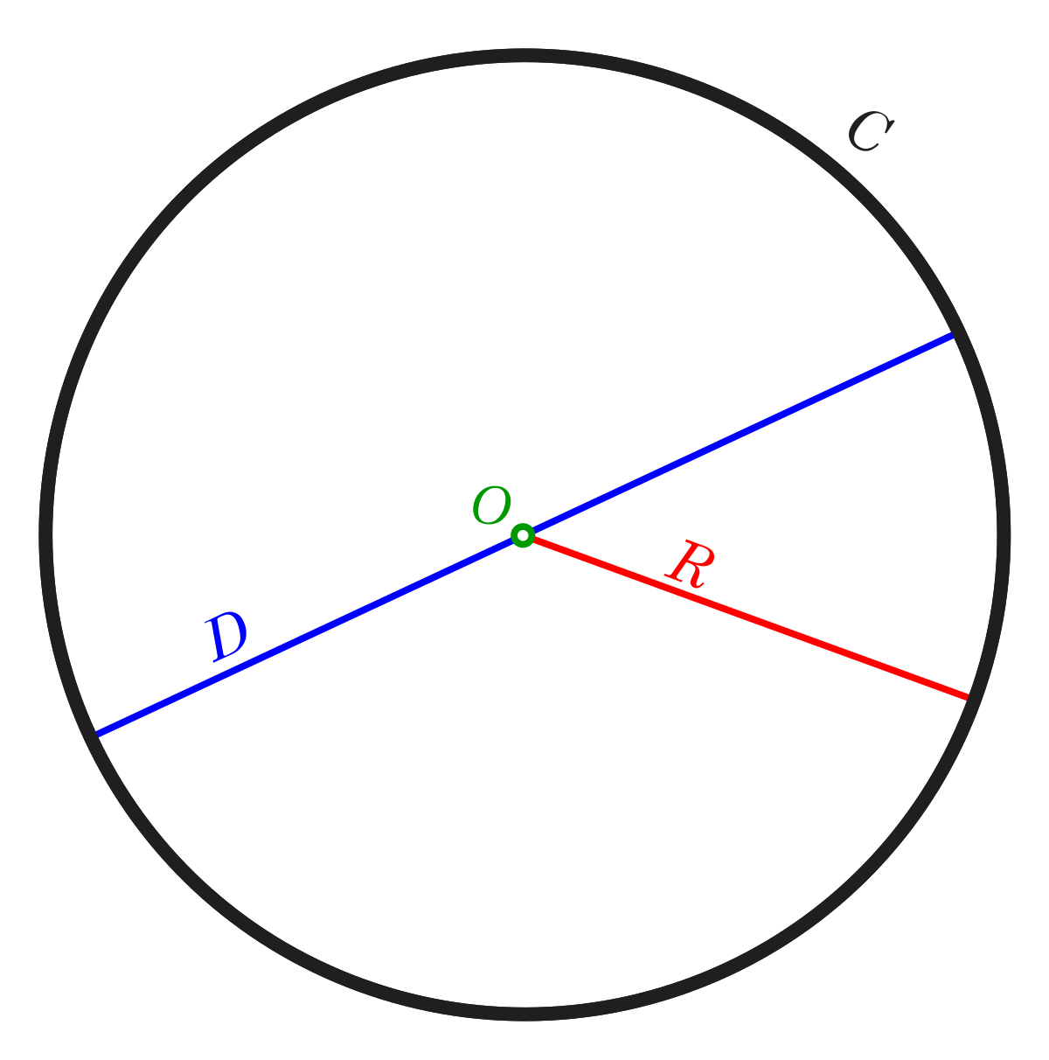
Circles
Circumference: diameter*pi or 2*radius*pi dπ or 2rπ
Area: radius*radius*pi r^2π
Pi is usually 3.14, unless otherwise stated.
You may sometimes be asked to express the answer in terms of pi. In that case, do not multiply the radius/diameter with 3.14, instead leaving it as xπ, where x is the diameter/ 2*radius/radius^2.
Example: the circle on the right has a diameter of 4. Find the circumference and area.

Slide 15
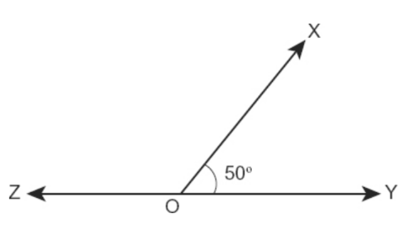
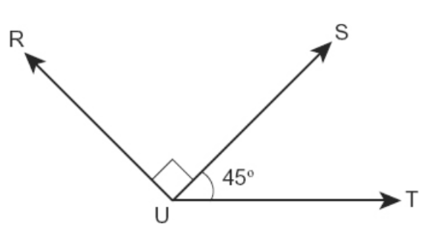
Angles
Quick refresher:
A right angle is 90 degrees.
A straight line (or all angles in a straight line) add up to 180 degrees.

Slide 16
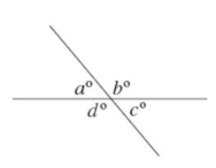
Vertical angles
When two lines intersect:
a and b are supplementary (they add up to 180) because they are on a straight line
Same thing for c and d
a and c are vertical angles and are congruent (equal to each other). b and d are also vertical and congruent.
Takeaway: When you have two intersecting lines:
The angles opposite each other are equal
The angles next to each other/adjacent add up to 180.

Slide 17
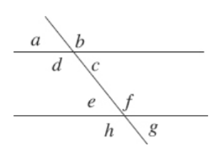
Alternate and corresponding angles
When you have two parallel lines and a line that cuts through both of them (transversal):
Corresponding angles are equal. Corresponding angles are angles that are in the same position on different parallel lines (b and f, c and g, a and e, d and h).
Be careful! c and f are not equal despite their positions looking similar.
Alternate angles are equal. These angles are on opposite sides of the transversal; you can think of them as forming a “Z”. Example: d and f, c and e, b and h, a and g.

Slide 18
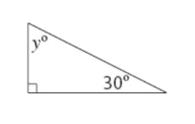
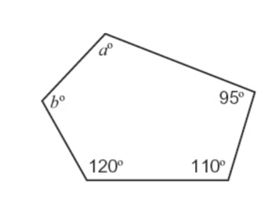
Polygons
A polygon is any shape with 3 or more sides.
Triangle = polygon with 3 sides.
Quadrilateral = polygon with 4 sides
Pentagon = polygon with 5 sides
Hexagon = polygon with 6 sides.
Total measure of the internal angles of a polygon: 180(n-2), where n is the number of sides
All angles in a triangle add up to 180.
All angles in a quadrilateral add up to 360.

